Slide 1
Something about Action Control in Behaviors
Presented By: Arsham

Slide 2
Outline
Behavior Types
Decision-making models
Action Control
Action Control Modulators

Slide 3
Behavior types
Habitual
Depend on History of reinforcement (TD-RL modeling)
Situation Recognition
Computational load (vs. Action choosing in Goal-directed)
Situation-action assignment
Dopamine as Prediction Error Signal
Goal-Directed
Not clearly understood (Model-based or something else)
Episodic future thinking
VTE
PFC & Hippocampus
Attention role
Action selection
OFC & V-Striatum
Attention makes flexibility
Pavlovian
Stimulus-Response
Primitive responses
Pavlovian Instrumental Transfer (PIT)
Hippocampal
In early stages of learning and decision making
Do what was early sufficient

Slide 4
Decision-making
Unified Decision-making
Habitual / Goal-Direct base
Hierarchical
Multiple Decision-making systems
Impulsive vs. Reflective
with central evaluation
Complete action selection

Slide 5
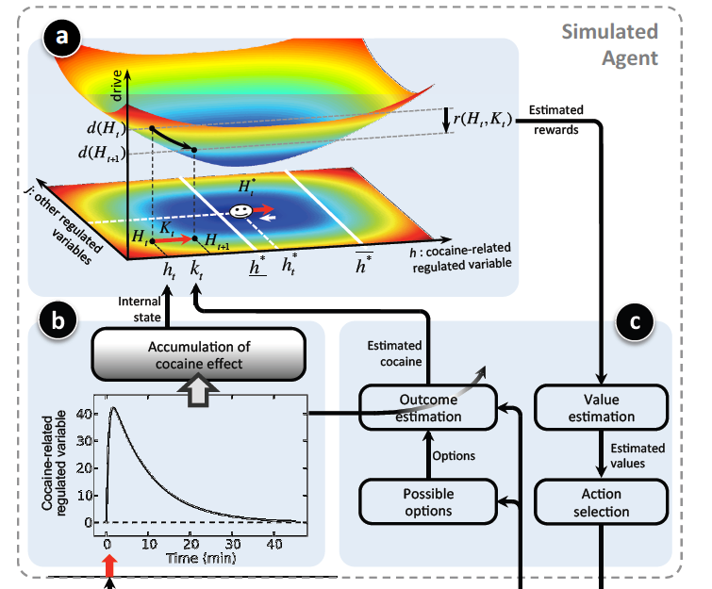
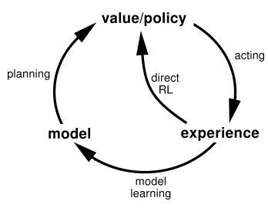
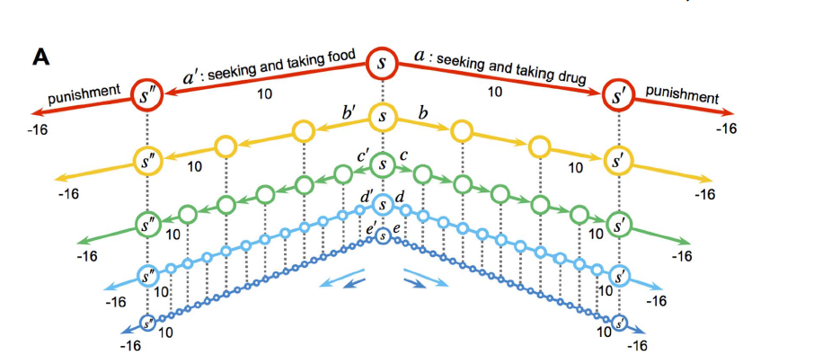
Unified Decision-making:
Habitual/ Goal-directed base
Fully Habitual
E.g. Actor/Critic
Fully Goal-Directed
E.g. Homeostatic
Mixed
E.g. Dyna-2 (!)
Hierarchical

Slide 6
Multiple Decision-making systems:
Impulsive vs. Reflective
Impulsive as Id and Reflective controls
Impulsive in Amygdala and reflective in VmPFC
All or non
Do not tell about How it’s computationally different
Central evaluation
Multiple decision making system exist but their values integrated in central control and action choose
Hierarchical (Goal-direct choose among Habitual ones)
Uncertainty in values Model
Cost/Benefit Model
Cost/Benefit for values (Unified decision-making system)(!)
Complete action selection
Multiple decision making system exist and their final selected action integrate
Go no-go model
Uncertainty in actions
Complete action selection with interaction?

Slide 7
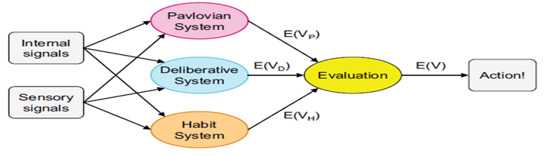
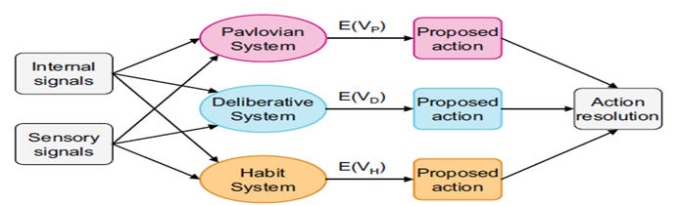
Action Control
Central evaluation
Complete action selection

Slide 8
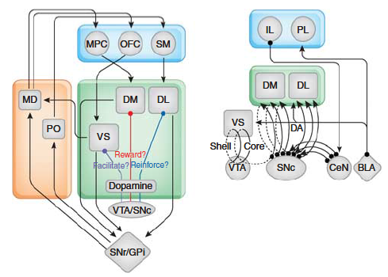
Action Control
Neural level

Slide 9
Action Control Modulators
Emotions:
Mostly:
Fear: Amygdala
Hedonia: Accumbens
Reward related: mostly cortex and v-striatum
PIT
Activate instrumental decision making (situation-action)
Time delay
Posterior VmPFC vs. Anterior
Posterior region has more connections to other decision making regions
Probability
Posterior VmPFC vs. Anterior
Attention
Makes Goal-directed process different
Focus on an output
Intensity of drive
Makes more impulsion
Intensity of brain regions activity
E.g. In drug usage
Dopamine
Opposite roles
Its not complete yet

Slide 10
Challenges
I must know:
How really action selection work
2. Its Modulators
Which modulators
How they influence
Their intensity
3. Computational Models
4. Tests

